Slide 1
LOTR Lord-Of-The-Ring
Amichai Ben-DAVID

Slide 2

Introduction
Introduction
RISCV
~20 minutes presentation.
~1-2 minutes per Title.
Part 1
Architectural idea.
Part 2
Workflow & Execution.
Idea
LOTR
RC
GPC_4T
Use-Case
Example
Execution
RISCV Tool-Chain
Verilog Simulation
GitHub
Design - RTL
Validation
POC - FPGA

Slide 3

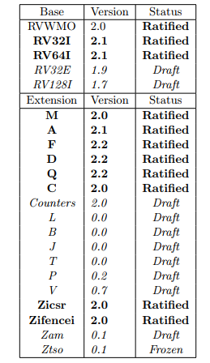
RISCV
Introduction
RISCV
Open ISA
freely available to academia and industry.
Avoids “Over-Architecting” for specific micro-arch/technology
microcode, in-order, decoupled, Out-Of-Order etc.
ASIC, FPGA, full-custom
Small “base” integer ISA
RV32I is usable by itself.
Customizable:
Optional Standard Extensions.
May add any Non-Standard Extensions.
Idea
LOTR
RC
GPC_4T
Use-Case
Example
Execution
RISCV Tool-Chain
Verilog Simulation
GitHub
Design - RTL
Validation
POC - FPGA

Slide 4
The Architectural idea
Introduction
RISCV
Idea
LOTR
RC
GPC_4T
Use-Case
Example
Execution
RISCV Tool-Chain
Verilog Simulation
GitHub
Design - RTL
Validation
POC - FPGA

Slide 5
Lord-Of-The-Ring
Introduction
RISCV
Idea
LOTR
RC
GPC_4T
Use-Case
Example
Execution
RISCV Tool-Chain
Verilog Simulation
GitHub
Design - RTL
Validation
POC - FPGA

Slide 6
Lord-Of-The-Ring
Introduction
RISCV
Typical Flow:
Load I_MEM
Idea
LOTR
RC
GPC_4T
Use-Case
Example
Execution
RISCV Tool-Chain
Verilog Simulation
GitHub
Design - RTL
Validation
POC - FPGA

Slide 7
Lord-Of-The-Ring
Introduction
RISCV
Typical Flow:
Load I_MEM
Execute Program – Local D_MEM
Idea
LOTR
RC
GPC_4T
Use-Case
Example
Execution
RISCV Tool-Chain
Verilog Simulation
GitHub
Design - RTL
Validation
POC - FPGA

Slide 8
Lord-Of-The-Ring
Introduction
RISCV
Typical Flow:
Load I_MEM
Execute Program – Local D_MEM
Access Non-Local D_MEM
Idea
LOTR
RC
GPC_4T
Use-Case
Example
Execution
RISCV Tool-Chain
Verilog Simulation
GitHub
Design - RTL
Validation
POC - FPGA

Slide 9
Lord-Of-The-Ring
Introduction
RISCV
Other options for Memory Mapped Agent:
Have an “Accelerator–Agent” instead of CORE for specific HW Accelerate calculation.
Idea
LOTR
RC
GPC_4T
Use-Case
Example
Execution
RISCV Tool-Chain
Verilog Simulation
Accelerator
GitHub
Design - RTL
Validation
POC - FPGA

Slide 10

Lord-Of-The-Ring
Introduction
RISCV
Idea
LOTR
RC
GPC_4T
Use-Case
Example
Execution
RISCV Tool-Chain
Verilog Simulation
GitHub
Design - RTL
Validation
POC - FPGA

Slide 11
Ring-Controller
Introduction
RISCV
Idea
LOTR
RC
GPC_4T
Use-Case
Example
Execution
RISCV Tool-Chain
Verilog Simulation
GitHub
Design - RTL
Validation
POC - FPGA

Slide 12
Ring-Controller
Introduction
RISCV
Data Path:
Core Request
Idea
LOTR
RC
GPC_4T
Use-Case
Example
Execution
RISCV Tool-Chain
Verilog Simulation
GitHub
Design - RTL
Validation
POC - FPGA

Slide 13
Ring-Controller
Introduction
RISCV
Data Path:
Core Request
Memory Response
Idea
LOTR
RC
GPC_4T
Use-Case
Example
Execution
RISCV Tool-Chain
Verilog Simulation
GitHub
Design - RTL
Validation
POC - FPGA

Slide 14
Ring-Controller
Introduction
RISCV
Data Path:
Core Request
Memory Response
Ring Input
Pass through
Idea
LOTR
RC
GPC_4T
Use-Case
Example
Execution
RISCV Tool-Chain
Verilog Simulation
GitHub
Design - RTL
Validation
POC - FPGA

Slide 15
Ring-Controller
Introduction
RISCV
Data Path:
Core Request
Memory Response
Ring Input
Pass through
F2C RD/WR to local Mem
Idea
LOTR
RC
GPC_4T
Use-Case
Example
Execution
RISCV Tool-Chain
Verilog Simulation
GitHub
Design - RTL
Validation
POC - FPGA

Slide 16
Ring-Controller
Introduction
RISCV
Data Path:
Core Request
Memory Response
Ring Input
Pass through
F2C RD/WR to local Mem
C2F RD_RSP
Idea
LOTR
RC
GPC_4T
Use-Case
Example
Execution
RISCV Tool-Chain
Verilog Simulation
GitHub
Design - RTL
Validation
POC - FPGA

Slide 17
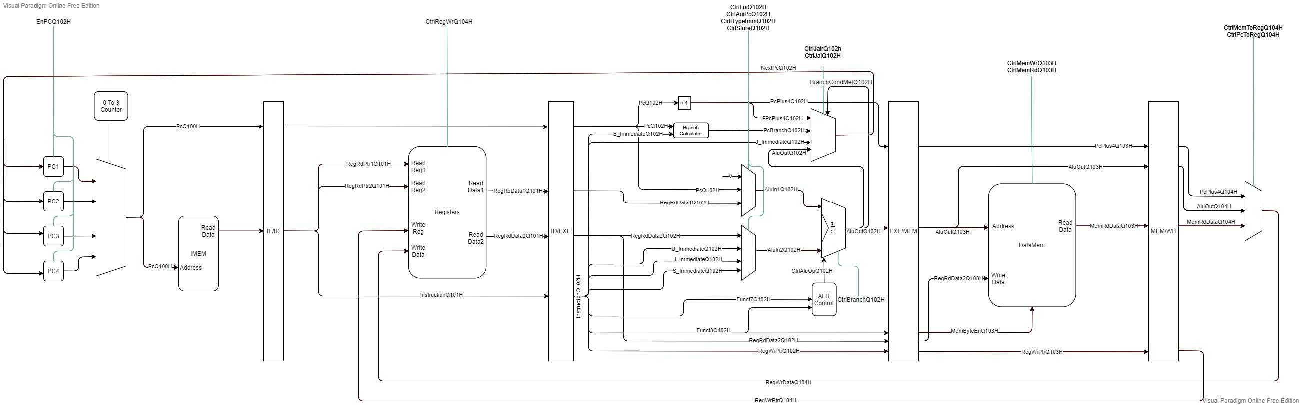
General-Purpose-Compute-Unit With 4 HW Threads
Introduction
RISCV - RV32I/E ISA compatible
RISCV
Idea
LOTR
RC
GPC_4T
Use-Case
Example
Execution
RISCV Tool-Chain
Verilog Simulation
GitHub
Design - RTL
Validation
POC - FPGA

Slide 18
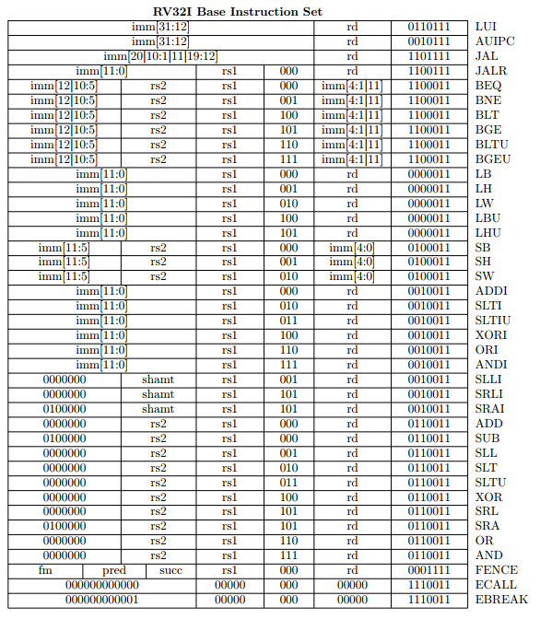
General-Purpose-Compute-Unit With 4 HW Threads
Introduction
RISCV - RV32I/E ISA compatible
RISCV
Idea
LOTR
RC
GPC_4T
Use-Case
Example
Execution
RISCV Tool-Chain
Verilog Simulation
GitHub
Design - RTL
Validation
POC - FPGA

Slide 19
General-Purpose-Compute-Unit With 4 HW Threads
Introduction
RISCV - RV32I/E ISA compatible
5 Stage Pipe-Line
RISCV
Idea
LOTR
RC
GPC_4T
Use-Case
Example
Instruction Fetch
Instruction Decode
Memory Access
Write Back
Execution
Execute
RISCV Tool-Chain
Verilog Simulation
GitHub
Design - RTL
Validation
POC - FPGA

Slide 20
General-Purpose-Compute-Unit With 4 HW Threads
Introduction
RISCV - RV32I/E ISA compatible
5 Stage Pipe-Line
4 HW Threads
4 x Program Counter && 4 x Register Files – See RED
Sharing Execution Logic and Memory Access – See Green
Thread IPC of ¼ - 1 Instruction every 4 Cycles.
RISCV
Idea
LOTR
RC
GPC_4T
Use-Case
Example
Instruction Fetch
Instruction Decode
Memory Access
Write Back
Execution
Execute
RISCV Tool-Chain
Verilog Simulation
GitHub
Design - RTL
Validation
POC - FPGA

Slide 21
General-Purpose-Compute-Unit With 4 HW Threads
Introduction
No Hazards.
No forwarding unit.
No Pipe Flush - no branch predictor.
No Context Switch.
No Interrupts.
No Thread Scheduler
Etc.
RISCV
Idea
LOTR
RC
GPC_4T
Use-Case
Example
Instruction Fetch
Instruction Decode
Memory Access
Write Back
Execution
Execute
RISCV Tool-Chain
Verilog Simulation
GitHub
Design - RTL
Validation
POC - FPGA

Slide 22
Use-Case
Introduction
Programable Accelerators.
Offload task from Main processor.
Multi HW Threaded accelerator.
Big-Data/Neural-Network/Machine-Learning.
Programable Controllers – Each controller gets an HW Thread.
RISCV
Idea
LOTR
RC
GPC_4T
Use-Case
Example
Execution
RISCV Tool-Chain
Verilog Simulation
GitHub
Design - RTL
Validation
POC - FPGA

Slide 23
Example Use-Case
Introduction
RISCV
Idea
TODO - Pseudo code for multi threaded accelerator. Have “switch case” for each Thread and use the CR “WHOAMI” to move Data around the threads and Cores.
LOTR
RC
GPC_4T
Use-Case
Example
Execution
RISCV Tool-Chain
Verilog Simulation
GitHub
Design - RTL
Validation
POC - FPGA

Slide 24
Workflow & Execution
Introduction
RISCV
Idea
LOTR
RC
GPC_4T
Use-Case
Example
Execution
RISCV Tool-Chain
Verilog Simulation
GitHub
Design - RTL
Validation
POC - FPGA

Slide 25
RISCV Tool-Chain
Introduction
RISCV
Idea
TODO
LOTR
RC
GPC_4T
Use-Case
Example
Execution
RISCV Tool-Chain
Verilog Simulation
GitHub
Design - RTL
Validation
POC - FPGA

Slide 26
Verilog Simulation
Introduction
RISCV
Idea
TODO
LOTR
RC
GPC_4T
Use-Case
Example
Execution
RISCV Tool-Chain
Verilog Simulation
GitHub
Design - RTL
Validation
POC - FPGA

Slide 27
GitHub
Introduction
RISCV
Idea
TODO
LOTR
RC
GPC_4T
Use-Case
Example
Execution
RISCV Tool-Chain
Verilog Simulation
GitHub
Design - RTL
Validation
POC - FPGA

Slide 28
Design - RTL
Introduction
RISCV
Idea
TODO
LOTR
RC
GPC_4T
Use-Case
Example
Execution
RISCV Tool-Chain
Verilog Simulation
GitHub
Design - RTL
Validation
POC - FPGA

Slide 29
Validation
Introduction
RISCV
Idea
TODO
LOTR
RC
GPC_4T
Use-Case
Example
Execution
RISCV Tool-Chain
Verilog Simulation
GitHub
Design - RTL
Validation
POC - FPGA

Slide 30
Proof Of Concept - FPGA
Introduction
RISCV
Idea
TODO
LOTR
RC
GPC_4T
Use-Case
Example
Execution
RISCV Tool-Chain
Verilog Simulation
GitHub
Design - RTL
Validation
POC - FPGA

